Slide 1
Project 12: Cost-Sensitive Boosting for Classification of Imbalanced Data
Mentor: Prof. Dr. Eirini Ntoutsi
Arab oghli, Omar
Kanafani, Hussain
Mughrabi, Muaid

Slide 2
Problem
Imbalanced Datasets: bias against minorities in dataset (fraud detection).
The promise of accuracy improvement is trivial in the context of the class imbalance problem, where accuracy is less meaningful.

Slide 3
Solution
Assign costs to instances to influence boosting algorithm.
Different adjustments, AdaCost1, AdaCost2, and AdaCost3.

Slide 4
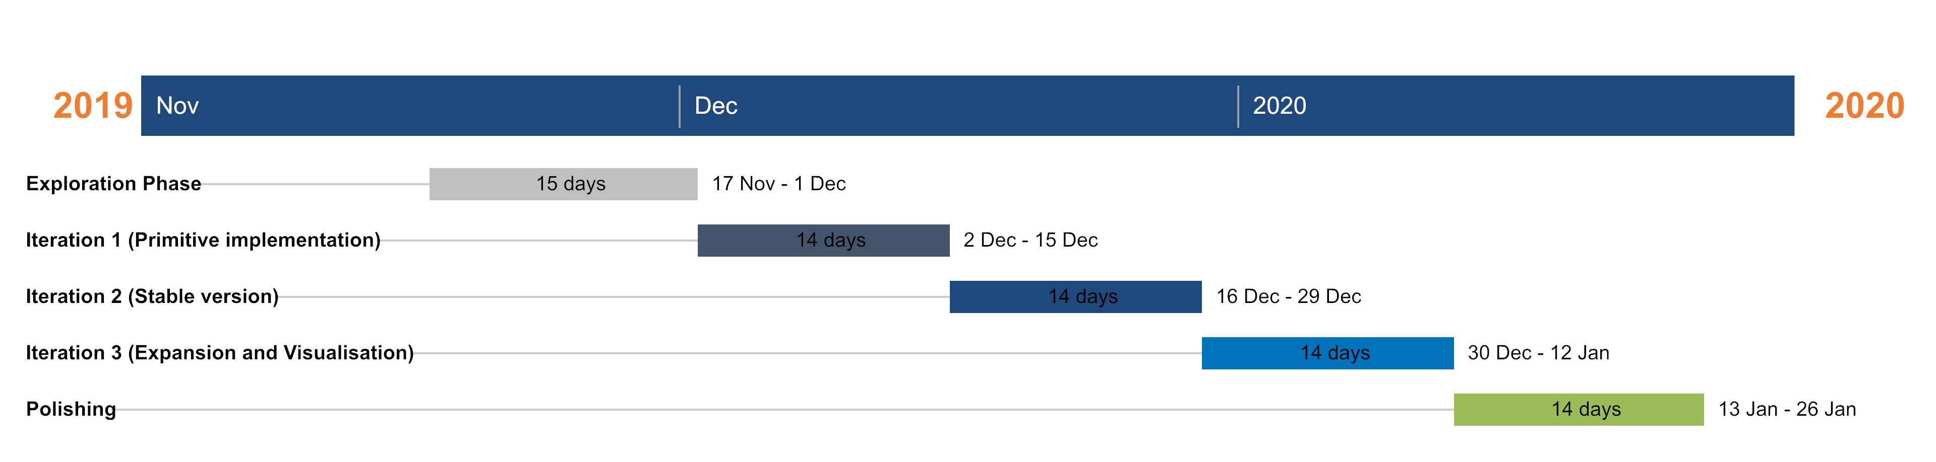
Suggested workflow

Slide 5
Q&As

